Slide 1
NPS MedicineWise
Safe use of opioids in acute pain
This program is funded by the Australian Government Department of Health.

Slide 2
Why is opioid stewardship important?
"Opioid use and misuse is having a critical impact on patients, their families and the health system. Every day in Australia, nearly 150 hospitalisations and 14 emergency department admissions involve opioid harm; and three people die from drug-induced deaths involving opioid use"
Therapeutic Goods Administration (TGA) https://www.tga.gov.au/publication/addressing-prescription-opioid-use-and-misuse-australia
Notes:
As per the AIHW (https://www.aihw.gov.au/reports/illicit-use-of-drugs/opioid-harm-in-australia/summary) Opioid harm in Australia 2018 publication and TGA (https://www.tga.gov.au/publication/addressing-prescription-opioid-use-and-misuse-australia).
In 2014, almost 3 million people in Australia were prescribed at least one opioid under the Pharmaceutical Benefits Scheme (PBS) or Repatriation PBS (RPBS). Since the end of 2009, there has been a general increase in opioid prescriptions, from about 10 million annually to 14 million annually.
Levels of prescription opioid overdose, including accidental overdose are at record levels in Australia and internationally. One of the contributing factors has been significant 'indication creep’, with increasing use in a range of types of chronic non-cancer pain, despite limited evidence of efficacy or safety for opioids. Use in chronic pain is also driven by the inconsistent efficacy of alternative medicines in chronic pain such as non-steroidal anti-inflammatory drugs (NSAIDs), gabapentoids, antidepressants and muscle relaxants; opioid analgesics are often used when pain is refractory to these other treatments. Judicious prescribing for some patients with chronic non-cancer pain has been described as an appropriate option.
Australia currently ranks eighth internationally on the numbers of defined daily doses of prescription opioids per million population (at about 40% the level of the USA). In the USA, opioid analgesics are now the most commonly prescribed class of medications.
Pharmaceutical opioid deaths in Australia now exceed heroin deaths by a significant margin - by 2-2.5 times - the reverse of what was seen in the 1990s. Between 2011 and 2015 there were 2,145 deaths associated with oxycodone, morphine, codeine, fentanyl, tramadol and/or pethidine compared with 985 due to heroin. Pharmaceutical opioid deaths particularly dominate in the over 30 age group.

Slide 3
Opioid Analgesic Stewardship in Acute Pain Clinical Care Standard
"The aim … clinical care standard is to minimise the risk of harm associated with opioid analgesic use."
Australian Commission of Safety and Quality in Health Care (ACSQHC) http://www.safetyandquality.gov.au/opioid-css
Released 27 April 2022
Notes:
Priority actions to reduce medication-related harm from high-risk medicines, including opioid analgesics, were identified in Australia’s response to the World Health Organization Global Patient Safety Challenge – Medication without harm (2020). One of the identified priority actions was the development of a national guideline for peri-surgical management of high-risk medicines, including the quantity prescribed at hospital discharge, the duration of therapy post-hospital, and where appropriate the introduction of de-escalation plans as part of the hospital discharge summary.
Following a public consultation on prescription opioids in 2018, the Therapeutic Goods Administration (TGA) established the Opioid Regulatory Advisory Group to provide independent, expert advice to review proposed options for a regulatory response to opioid use and misuse in Australia. As a result, a number of opioid regulatory changes were implemented June 2020.
In April 2020, the TGA engaged the Commission to develop a framework for a National Opioid Analgesic Stewardship program, and an accompanying clinical care standard, which together support the opioid analgesic regulatory changes. The aim of the TGA regulatory changes, the National Opioid Analgesics Stewardship program and the accompanying clinical care standard is to minimise the risk of harm associated with opioid analgesic use.

Slide 4
Safe use of opioids in acute pain toolkit
Supporting the ACSQHC’s Opioid Analgesic Stewardship in Acute Pain Clinical Care Standard
Designed by NPS MedicineWise in collaboration with clinical experts and stakeholders to provide key clinical messages in an easy to digest format
Two information resources
Safe use of opioids in the Emergency Department
Safe use of opioids in the Surgical patient
Notes:
The Safe use of opioids in Acute Pain toolkit was developed by NPS MW through department of health funding. To Support the Quality Statements with the Clinical Care Standards this resources is designed as an overview of best practice of the treatment of acute pain with both the Emergency Department and the Surgical patient as identified in the Clinical Care Statement.

Slide 5
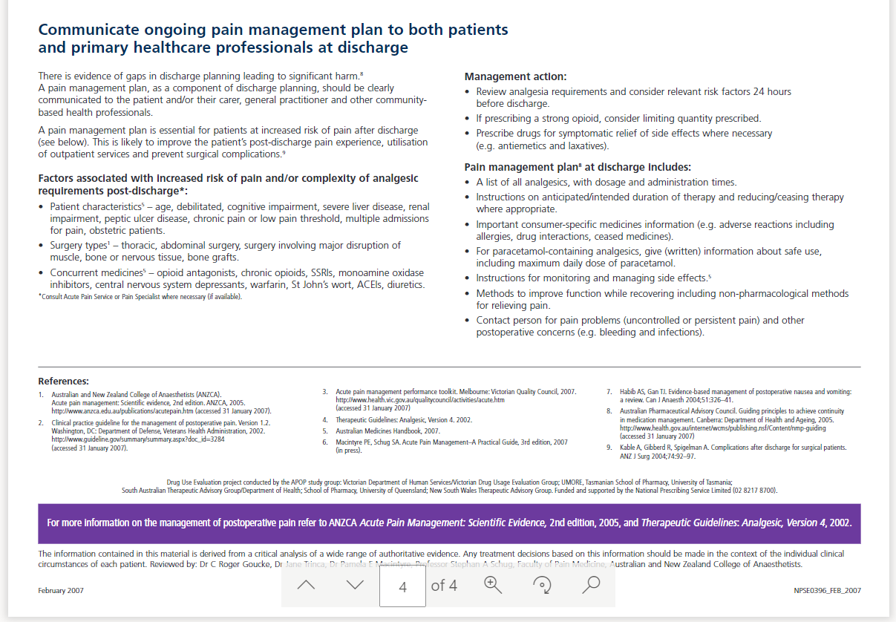
Development process
Developed from the 2007 NPS MedicineWise Acute postoperative pain management resource.
Reviewed by the ACSQHC Topic Working group to identify content requiring updates and missing content.
Notes:
In 2007 NPS MedicineWise ran an educational visiting program educating prescribers and pharmacists on acute post-operative pain, this educational program was developed with funding from the Australian Government Department of Health. This education program formed the basis of our updated Safe use of opioids in acute pain resource.
This resource was reviewed by the ACSQHC Topic Working group for the Opioid Analgesic Stewardship in Acute Pain Clinical Care Standard, a group of experts in the use of opioids and pain managements across multiple disciplines (Emergency, Orthopaedic Surgery, Paediatric Surgery, General Surgery, Pain Management).

Slide 6
Development process
Content then developed with experts within Opioid Safety
Prof. Pamela Macintyre FANZCA – Emeritus Consultant in Anaesthesia and Pain Medicine, Royal Adelaide Hospital and Clinical Professor, Adelaide Medical School, University of Adelaide
Dr. Kim Hattingh FANZCA - Specialist Pain Physician at Bendigo Health.
Dr. Rhys Ross-Browne FACEM – Staff Specialist in Emergency Medicine at Campbelltown and Camden Hospital and Conjoint Lecturer at Western Sydney University School of Medicine.
Tested with a large group of front-line clinicians (pharmacists, medical officers, nurses, GPs) and consumers
Notes:
Professor Pamela Macintyre is the previous director of the Acute Pain Service at the Royal Adelaide Hospital and the co-author of Acute Pain Management: a Practical Guide 5th edition.
Dr. Kim Hattingh is a Specialist Pain Physician at Bendigo Hospital, Bendigo Health
Dr. Rhys Ross-Browne is a Staff Specialist in Emergency Medicine at Campbelltown and Camden Hospital, NSW Member, Council of Advocacy, Practice & Partnerships, Australasian College for Emergency Medicine and Conjoint Lecturer at Western Sydney University School of Medicine
The testing group consisted of 44 clinicians (pharmacists, medical officers, nurses and GPs) across all states in Australia. The document was also reviewed by consumers with a lived experience of acute and chronic pain.

Slide 7
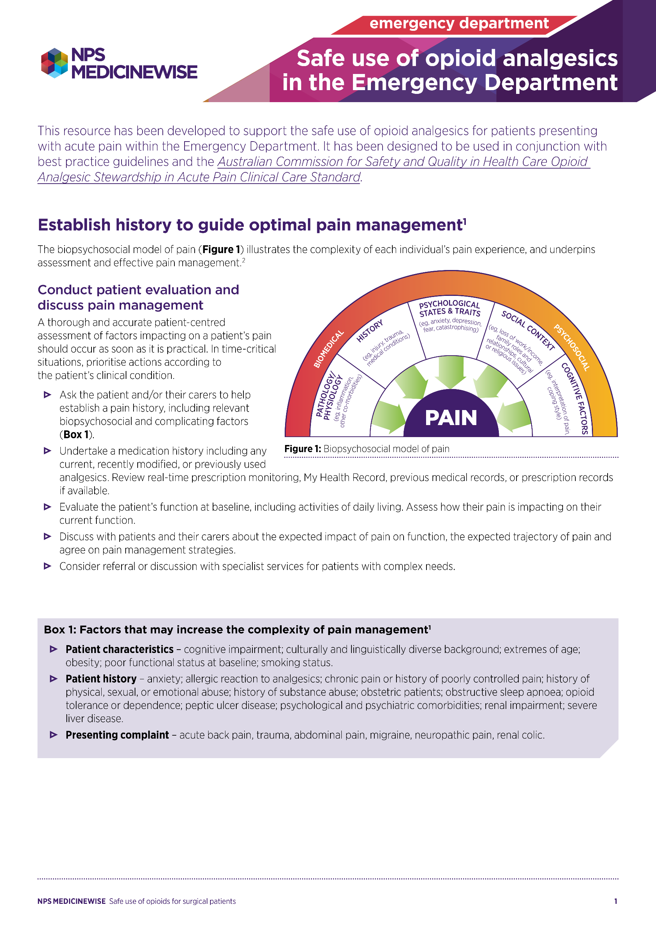
Safe use of opioids in acute pain

Slide 8
Recommended uses of the safe use of opioids in acute pain toolkit
Supplementary educational resource for junior clinicians within both emergency departments and surgical areas
Reflective review on your own practice using the resource as a guide
Checklist for review of group practice
Checklist for review of systems in place to support best practice
Notes:
The resources can be utilised in many different ways:
as a supplementary educational resource for junior clinicians (nurses, pharmacists, medical officers, allied health professionals) to supplement educational programs run by clinical education providers
by clinicians to reflect on their current practice and how it they can ensure they are practicing best practice
by groups of clinicians to reflect on their practise as a group and ensure they setting standards based on best practise
by managers to ensure that systems are in place to allow clinicians to undertake best practice.

Slide 9
Further reading
NPS MedicineWise: Pain Management Hub - https://www.nps.org.au/pain-management-hub
Acute Pain Management: Scientific Evidence Australian and New Zealand College of Anaesthetists and Faculty of Pain Medicine Fifth edition 2020 - https://www.anzca.edu.au/getattachment/38ed54b7-fd19-4891-9ece-40d2f03b24f9/Acute-Pain-Management-Scientific-Evidence-5th-edition
Therapeutic Guidelines: Pain and Analgesia - https://www.tg.org.au/
ANZCA Statement regarding the use of opioid analgesics in patients with chronic non-cancer pain - https://www.anzca.edu.au/getattachment/7d7d2619-6736-4d8e-876e-6f9b2b45c435/PS01(PM)-Statement-regarding-the-use-of-opioid-analgesics-in-patients-with-chronic-non-cancer-pain
ACSQHC Opioid Analgesic Stewardship in Acute Pain Clinical Care Standard - http://www.safetyandquality.gov.au/opioid-css
TGA Prescription Opioids Hub - https://www.tga.gov.au/hubs/prescription-opioids
Notes:
Further reading on acute pain and best practice can be found at the following links.

Slide 10
Feedback and questions
Full toolkit is available at: www.nps.org.au/safe-use-of-opioids-in-acute-pain
Any feedback on the resource should be directed to NPS MedicineWise at info@nps.org.au
Notes:
If you have any feedback regarding the toolkit, resources, slide deck or any of NPS MedicineWise work, please contact us on info@nps.org.au.

